Slide 1
AI VIRTUAL MOUSE
February
2022
Under the Guidence
Of
Prof.Rajini.G.K

Slide 2
PRESENTED BY
19BEI0103 – P.Chakradhar
19BEI0083 – B.Siva Santosh Kumar

Slide 3
ABSTRACT
The mouse is one of the wonderful inventions of Human-Computer Interaction (HCI) technology. Currently, wireless mouse or a Bluetooth mouse still uses devices and is not free of devices completely since it uses a battery for power and a dongle to connect it to the PC. In the proposed AI virtual mouse system, this limitation can be overcome by employing webcam or a built-in camera for capturing of hand gestures and hand tip detection using computer vision. The algorithm used in the system makes use of the machine learning algorithm. Based on the hand gestures, the computer can be controlled virtually and can perform left click, right click, scrolling functions, and computer cursor function without the use of the physical mouse. The algorithm is based on deep learning for detecting the hands. Hence, the proposed system will avoid COVID-19 spread by eliminating the human intervention and dependency of devices to control the computer.

Slide 4
OBJECTIVE
In our project, we attempted to control mouse cursor movement and click events using a color detection approach based on a camera. It's a system that performs image processing, retrieves needed details, and then adds them to the computer's mouse interface using predefined notations. The code is written in Python, and it employs the cross-platform image processing module OpenCV as well as the Python-specific library PyAutoGUI to implement mouse actions. Only the three colored finger caps are extracted from the real-time video captured by the webcam. Their centers are calculated, and the action to be taken is determined based on their relative positions.

Slide 5

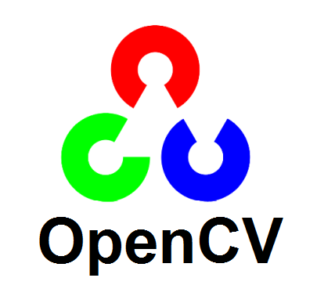
REQUIREMENTS:
Following modules need to be installed :
OpenCV
Mediapipe
Autopy

Slide 6
OpenCV:
OpenCV is a huge open-source library for computer vision, machine learning, and image processing. OpenCV supports a wide variety of programming languages like Python, C++, Java, etc. It can process images and videos to identify objects, faces, or even the handwriting of a human.
Mediapipe:
MediaPipe is a framework for building multimodal (eg. video, audio, any time series data), cross platform (i.e Android, iOS, web, edge devices) applied ML pipelines.
Autopy:
AutoPy is a simple, cross-platform GUI automation library for Python. It includes functions for controlling the keyboard and mouse, finding colors and bitmaps on-screen, and displaying alerts.

Slide 7
METHODOLOGY
HAND IMAGE
HAND DETECTION
PRE-PROCESSING
FEATURE EXTRACTION
RECOGNISATION
EXECUTION
COMMAND

Slide 8
THANK YOU

